Slide 1
Day 15 - Graphs!
BFS/DFS
Math 495R (Sec 9) - Competitive Coding

Slide 2
Business
BFS/DFS Problem Set Due Saturday
Programming Competition! TBD, will announce Thursday

Slide 3
Review Divide and Conquer
Closest Points

Slide 4
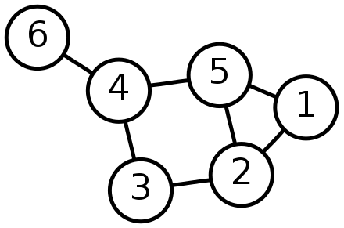
Graphs
Collection of Vertices and Edges
Directed/Undirected
When talking about runtime, use V and E
Typical Representations in Python:
Dictionary of Adjacency Lists
Adjacency Matrix
Graph Class

Slide 5
Breadth/Depth First Search
Algorithms for searching a matrix from a specific starting node
Similarities: Common variables - visited (set), nodes to be searched (deque), often stores distance (dictionary), often parent (dictionary for tracing path)
Difference: BFS searches all adjacent nodes first and then goes to their neighbors, while DFS searches until it reaches the end of a path and then returns
In implementation, BFS uses a QUEUE, while DFS uses a STACK
Runtime: Both - Worst Case O(V + E), but in practice often much better

Slide 6
Common Uses
BFS - shortest path, spanning tree
DFS - a path, spanning tree

Slide 7
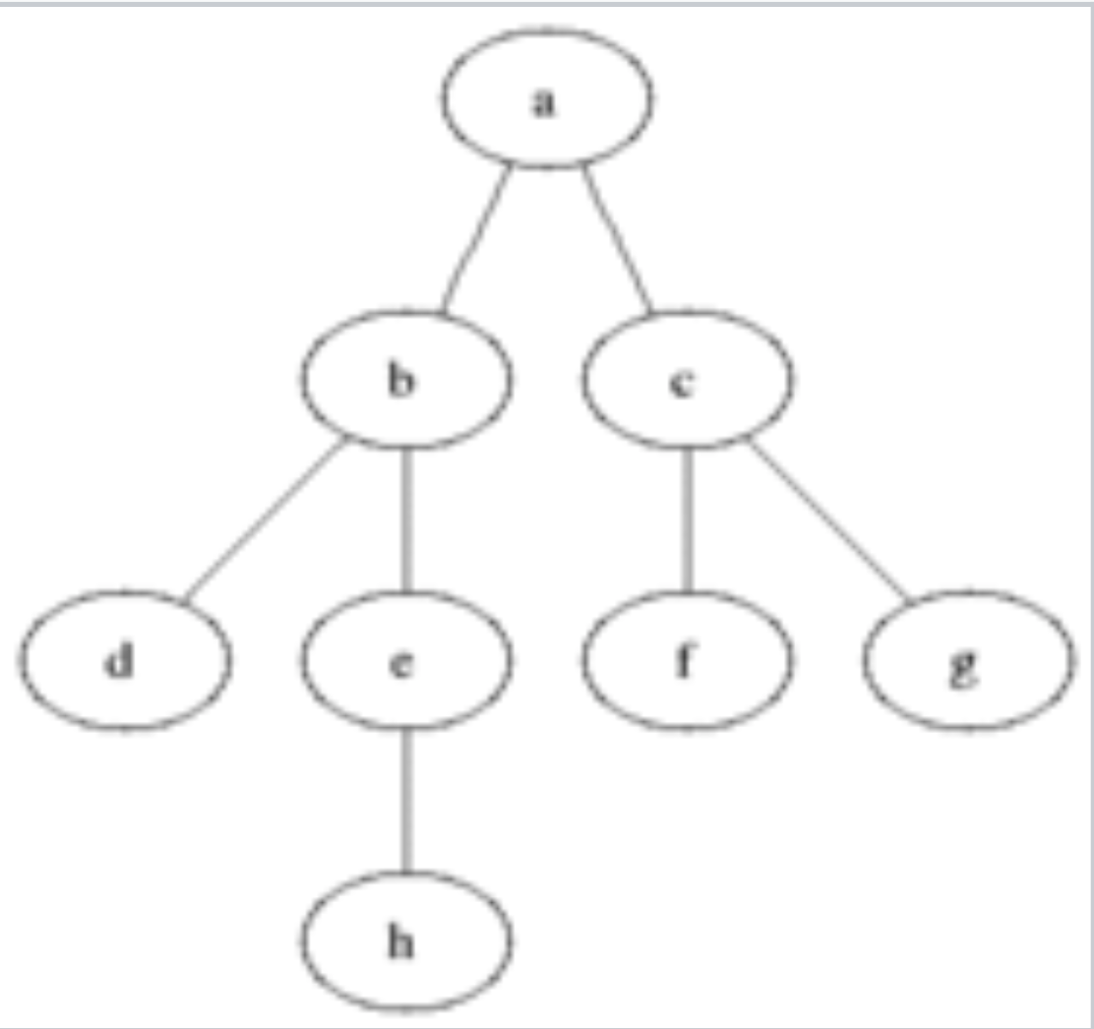
Example
BFS Output:
abcdefgh
DFS Output:
abdehcfg

